Slide 1

Presentation on “Title: Evaluation of Git & GitHub”
Name of Subject: Version Control System
Presented by
Sairaj Abhale 2124UMLM2027
Akshay Kharpas 2124UMLM2025
Pramod Khalkar 2124UMLM2047
Swadesh Turkane 2124UMLM2026
Dr. Devyani Jadhav
Course I/C
Department of Artificial Intelligence & Machine Learning
School of Engineering & Technology
Sanjivani University
Semester-IV, Academic Year 2024-2025

Slide 2
Introduction
What is Git?
- A version control system that tracks code changes.
- Works offline and supports teamwork.
Why is it GitHub?
- A cloud-based platform for hosting Git projects.
- Allows teams to share, review, and manage code efficiently.
Why is it GitHub?
- Keeps Code Safe – Prevents accidental changes or loss.
- Tracks Changes – Saves every version, so you can go back if needed.
- Makes Teamwork Easy – Multiple people can work on the same project.
- Improves Collaboration – Developers can suggest and review changes.

Slide 3
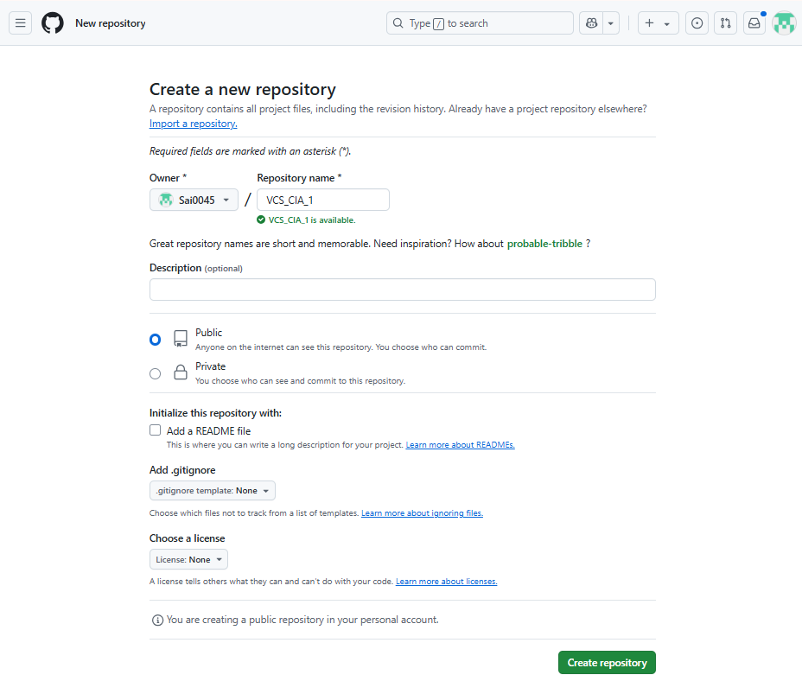
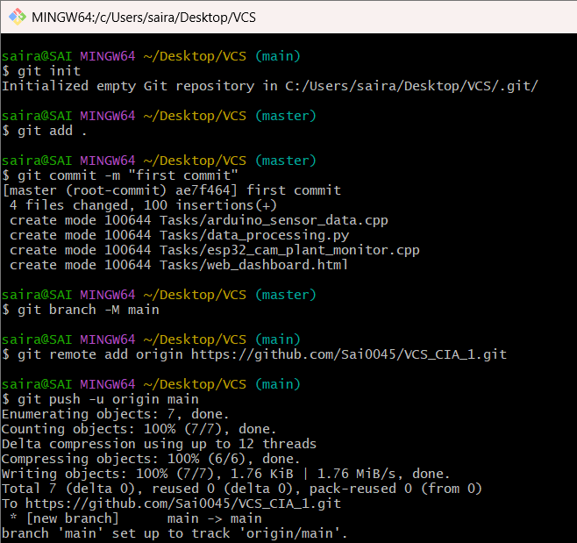
Repository Setup
Creating a Repository:
- Log in to GitHub and create a new repository.
- Set visibility (public or private).
- Initialize with a README file.
- Add File or Folder.
Adding Collaborators:
- Navigate to Settings > Manage Access > Invite Collaborators.
- Each team member accepts the invitation.
Cloning the Repository Locally:
- git clone <repository_url>
- cd <repository_name>

Slide 4
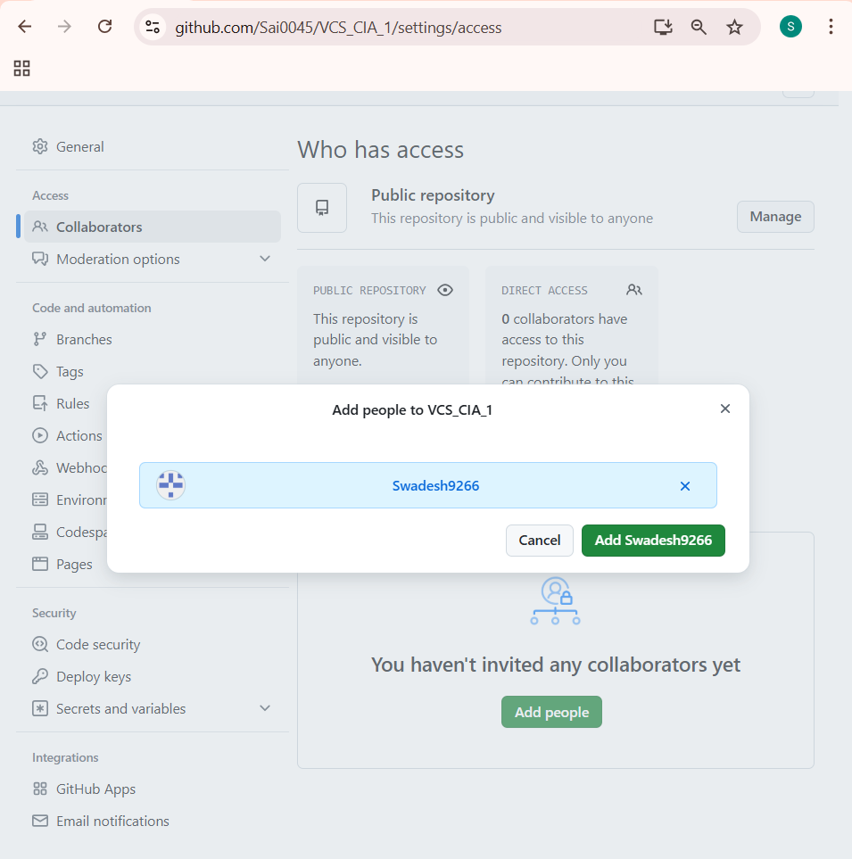
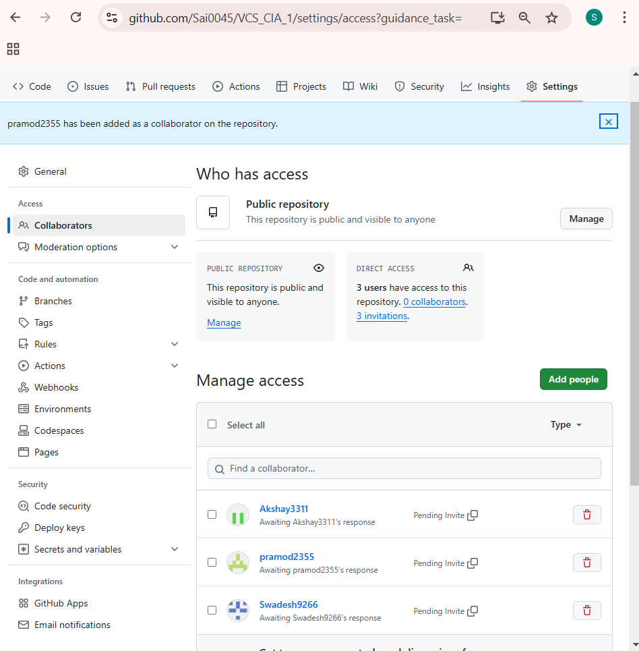
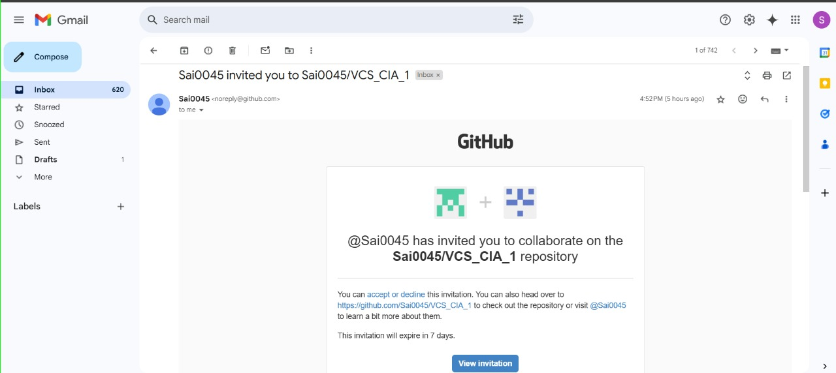

Slide 5
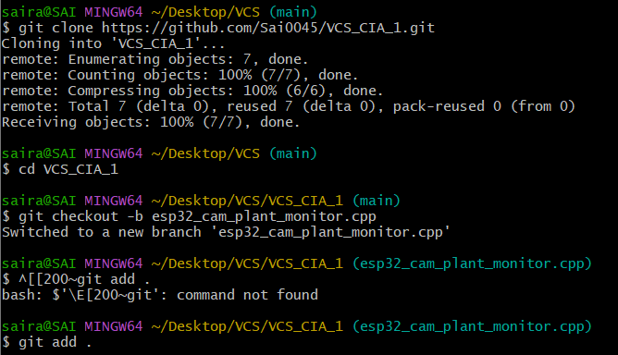
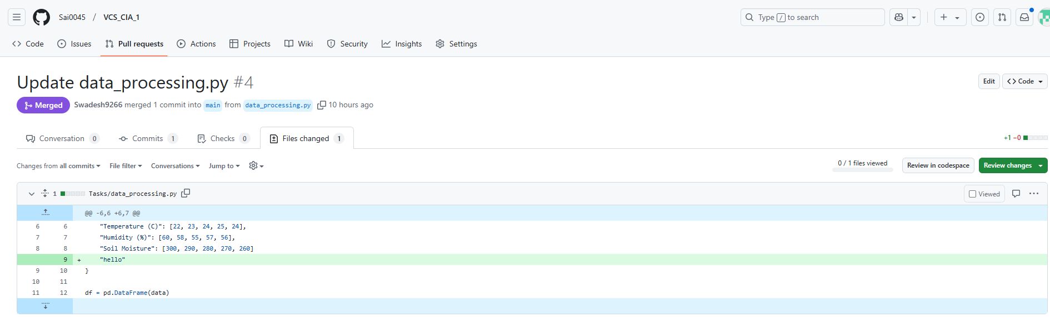
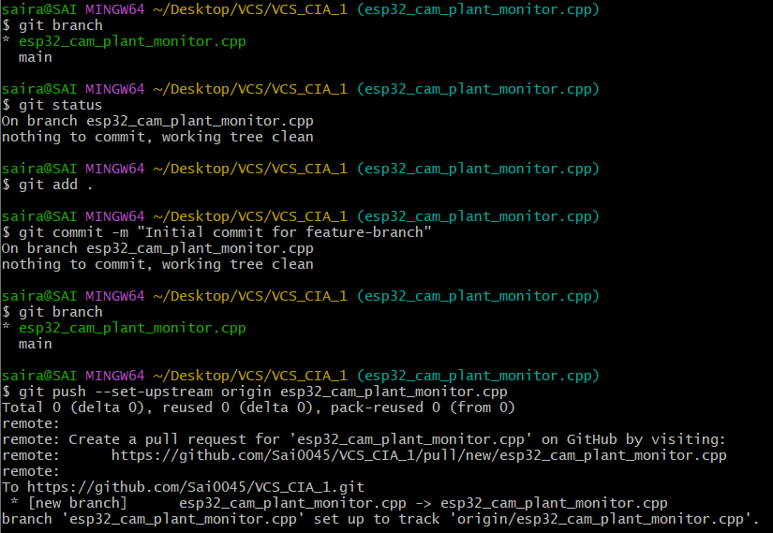

Slide 6
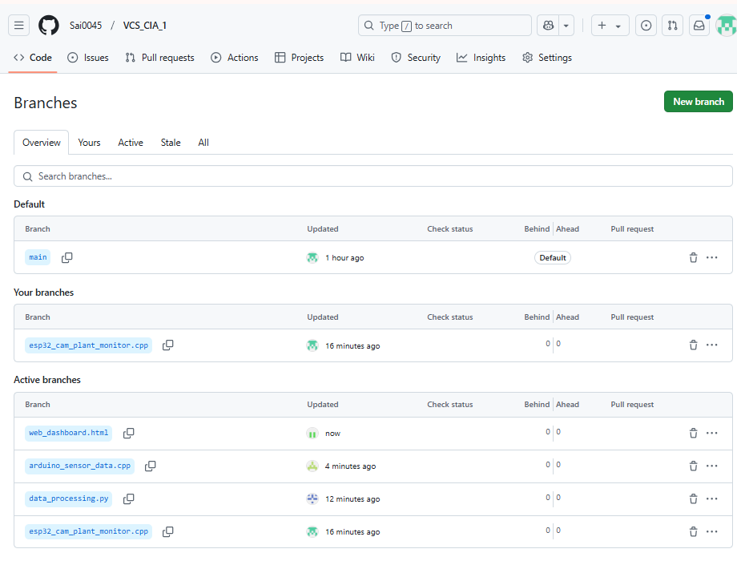
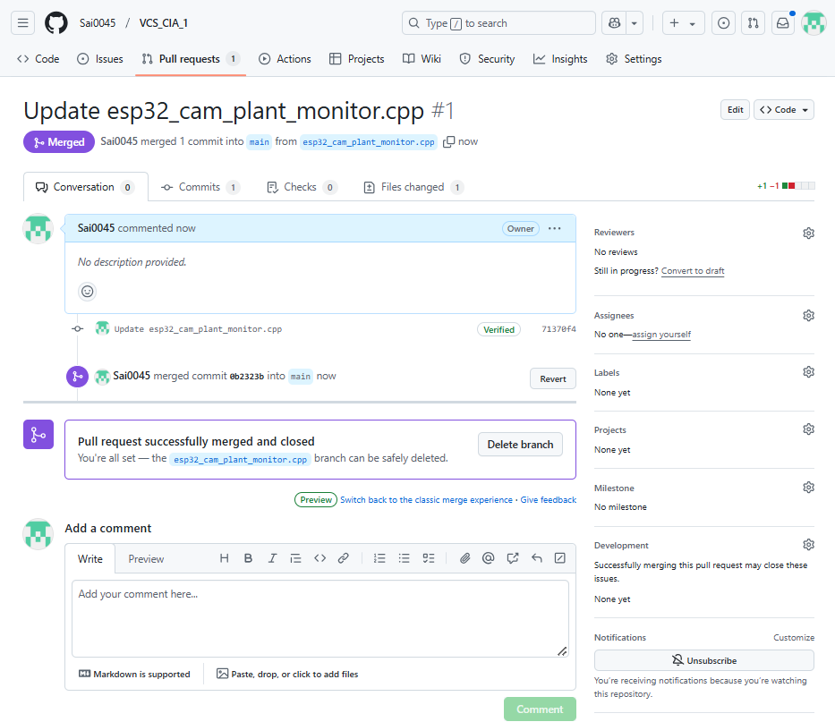
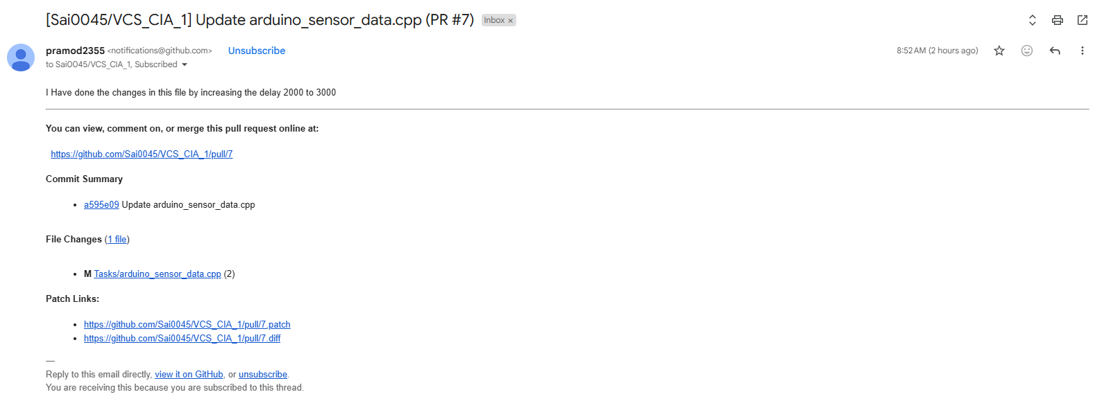
Branching & Merging
What is a Branch?
A parallel version of the project where new features can be developed.
Creating a New Branch:
git checkout -b feature-branch
Making Changes and Committing:
git add .
git commit -m "Added new feature"
Pushing the Branch to GitHub:
git push origin feature-branch
Merging via Pull Request:
Open a pull request on GitHub.
Get reviews from team members.
Merge the changes into main.

Slide 7
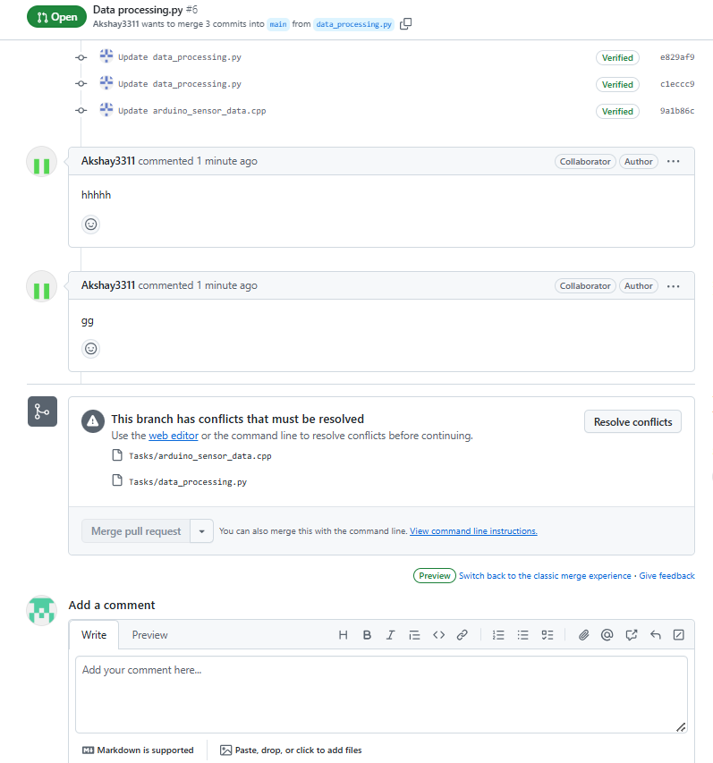
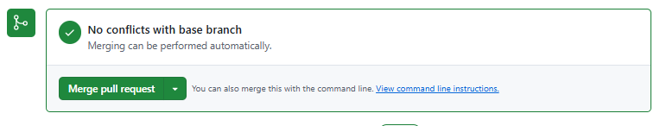

Commit Management & Conflict Resolution
Importance of Good Commit Messages:
Example: git commit -m "Refactored login function"
Creating a Merge Conflict:
- Two members edit the same file.
- Both push changes, leading to a conflict.
Resolving Conflicts:
- git add .
- git commit -m "Resolved merge conflict"
- git push origin main

Slide 8
Documentation & Collaboration
Maintaining a README.md File:
- Project Overview: A short and simple description of what the project does.
- Team Contributions: List of team members and what each person worked on.
- How to Use the Code: Step-by-step instructions on how to download, install, and run the project.
- Dependencies: Any software or tools required to use the project (e.g., Python, libraries, frameworks).
- Example Usage: Show a sample command or screenshot demonstrating how the project works.
- Future Improvements: Any planned updates or additional features that can be added later.

Slide 9
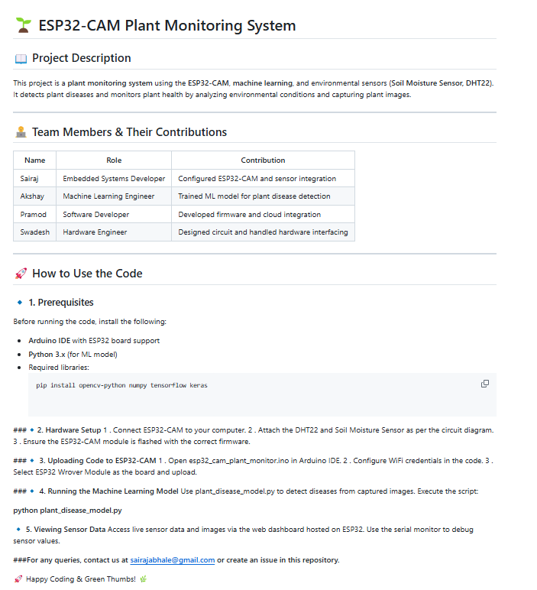
README.md File

Slide 10
Challenges & Solutions
Challenges Faced:
Merge conflicts.
Managing multiple branches.
Communication issues.
Solutions Implemented:
Followed best commit practices.
Used GitHub Issues for tracking.
Regular team discussions.

Slide 11
Conclusion
Git and GitHub are very useful tools for working together on code. In this project, we learned how to manage our code, track changes, and collaborate using branches and pull requests. Version control helped us avoid mistakes and keep everything organized. Writing a README.md file made it easier to understand and use the project. Using GitHub Issues and Discussions helped us communicate and manage tasks better. Overall, this experience showed us how important version control, teamwork, and good documentation are in any software project.

Slide 12
THANK YOU FOR YOUR ATTENTION

